Slide 1
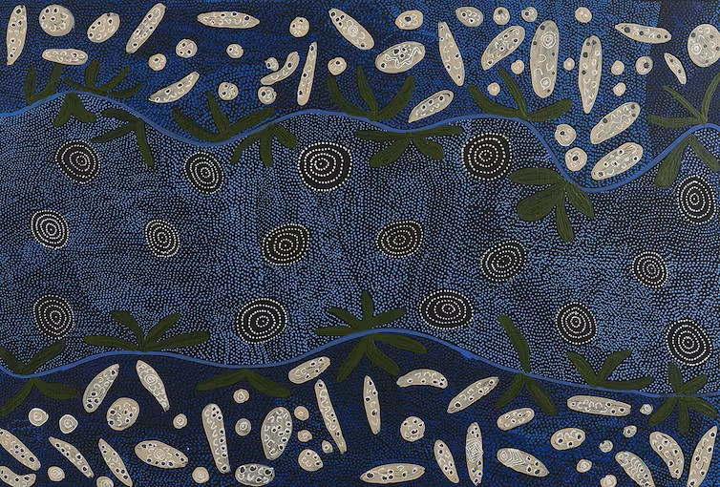
Indigenous Hydropoetics
Voicing Rivers through Aboriginal Australian Poetry
John Charles Ryan
Southern Cross University, Australia
Nulungu Institute, University of Notre Dame, Australia
27 February 2023, 1:15–1:40pm Brunei (12.15-12:40am New York)
Notes:
Welcome to my presentation, Indigenous Hydropoetics: Voicing Rivers Through Aboriginal Australian Poetry. I’m John Ryan, affiliated with Southern Cross University and the University of Notre Dame, Australia. In what follows, I propose the idea of Indigenous hydropoetics to describe an approach to rivers and their conservation that incorporates the sustainable hydrological values of Indigenous people. As evident in the poetry of Aboriginal Australian writers, Indigenous cultural groups across Australia hold in common a custodial ethics of rivers shaped by ancestral connections to water. For instance, artist Lola Brown’s painting Water Dreaming, shown here, evokes her connection to a large sacred waterhole near in the Northern Territory where ancestral spirits reside. After theorising the term Indigenous hydropoetics, I’ll give examples of hydropoetic sensibilities in the work of three Aboriginal writers, Jack Davis in Western Australia, Samuel Wagan Watson in Queensland, and Jeanine Leane in New South Wales.

Slide 2
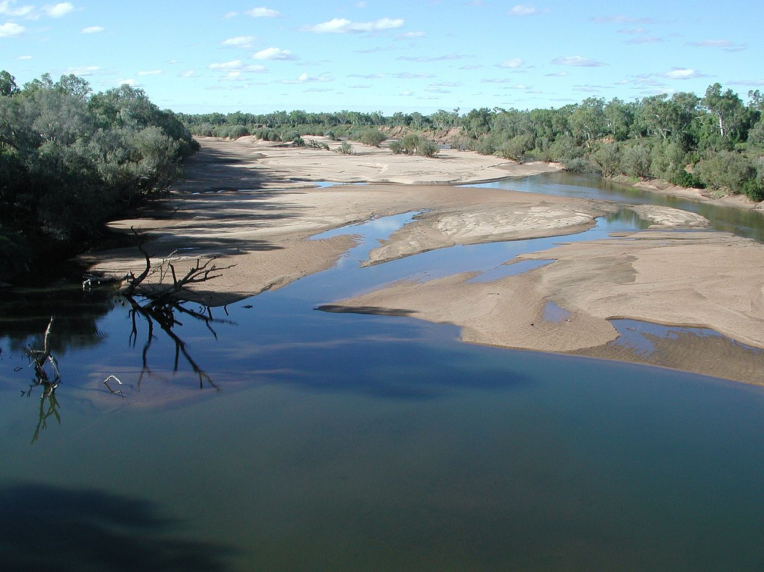
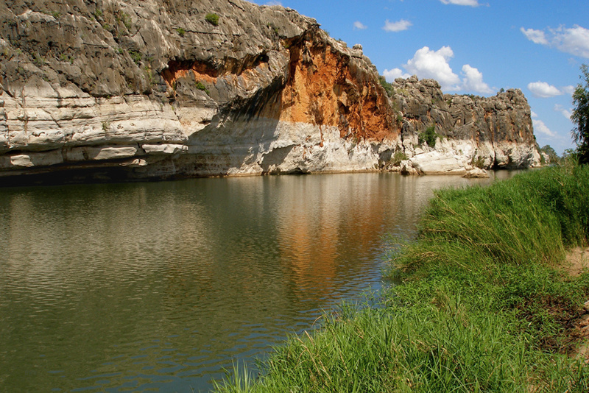
Indigenous Hydropoetics
Involves corporeal relations based on ancestral narratives and knowledge
Counters terracentrism, the privileging of the terrestrial over the aquatic
Embraces hydrocentricism and hydrophilia, the love of rivers as kin
Recognises the agencies of rivers
Acknowledges the intrinsic languages and semiosis of rivers
Attunes to the poietic transformation of river bodies over time
Confers respect to rivers as fellow beings and percipient interlocutors
Martuwarra (Fitzroy River), Western Australia
Notes:
Here are some of the principal characteristics of an Indigenous hydropoetics: involves corporeal relations based on ancestral narratives and knowledge; counters terracentrism, the privileging of the terrestrial over the aquatic; embraces hydrocentricism and hydrophilia, the love of rivers as kin; recognises the agencies of rivers; acknowledges the intrinsic languages and semiosis of rivers; attunes to the poietic transformation of river bodies over time; confers respect to rivers as fellow beings and percipient interlocutors

Slide 3
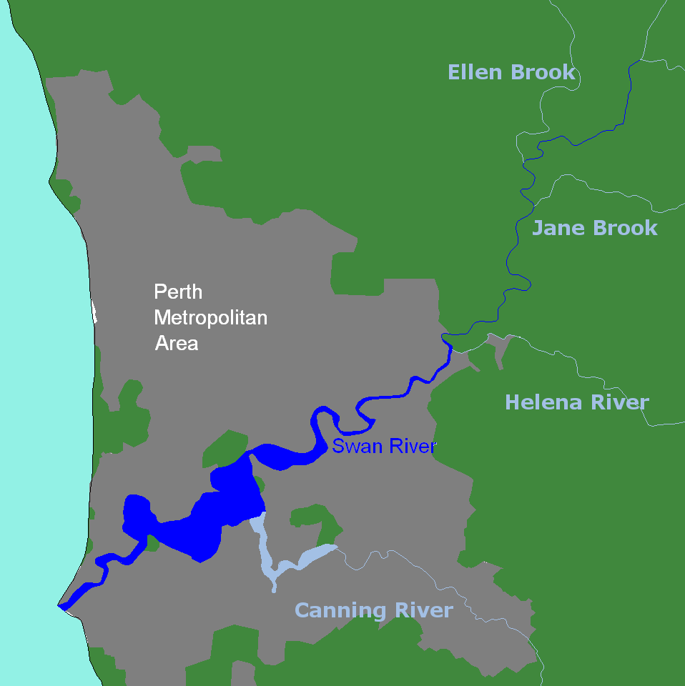
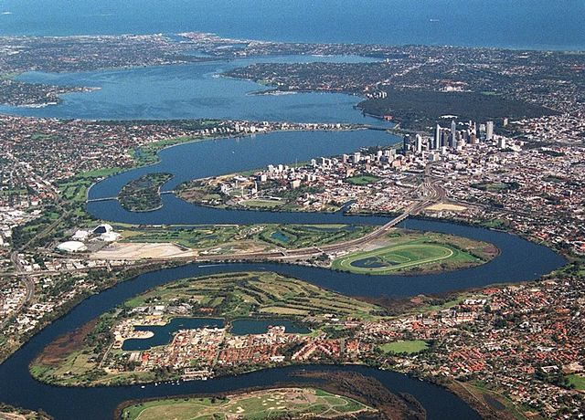
Derbal Yerrigan and Wagyl
Jack Davis’ Swan River Hydropoetics
Left: Map of the Swan River from source to sea Right: The Swan River near the city of Perth, Western Australia
Notes:
Let’s begin with Derbal Yerrigan, the Swan River, which flows from the Wheatbelt region of Southwest Australia to its mouth at the port of Fremantle on the Indian Ocean. In the language of the Noongar people of the region, the name Derbal Yerrigan denotes “mixing and flowing” in reference to the combination of fresh and salt water as well as the influence of ocean currents on the river.

Slide 4
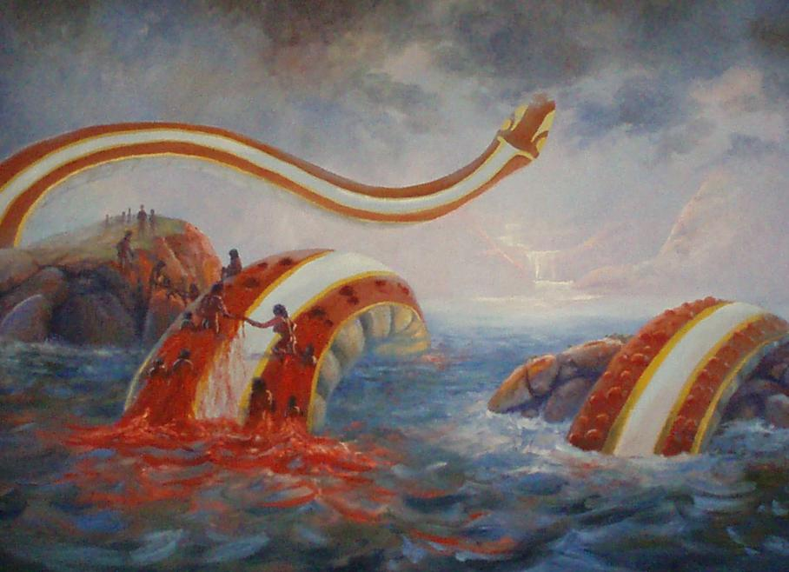
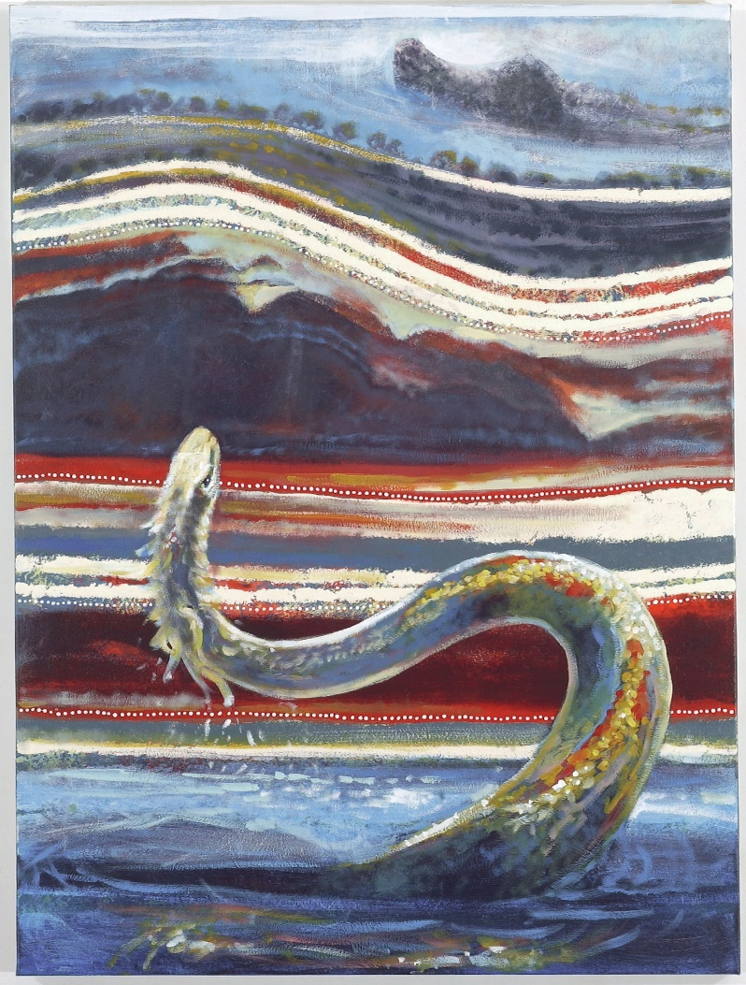
Left: Waagle - Rainbow Serpent by Shane Pickett (1983) Right: Waagle and Yondock Story by Shane Pickett (2004)
Notes:
The Noongar recognise the Wagyl as a major creation being who protects Derbal Yerrigan and other freshwater sources. As depicted in these paintings by Noongar artist Shane Pickett, the Wagyl represents the interdependent relationship between all freshwater bodies—seas, estuaries, rivers, wetlands and groundwater—and safeguards kayepa dordok or “living water.” The twists and turns of Derbal Yerrigan from source to sea indicate the path journeyed by Wagyl as the rainbow serpent’s movements across the ancient landscape produced the region’s hydrological features.

Slide 5
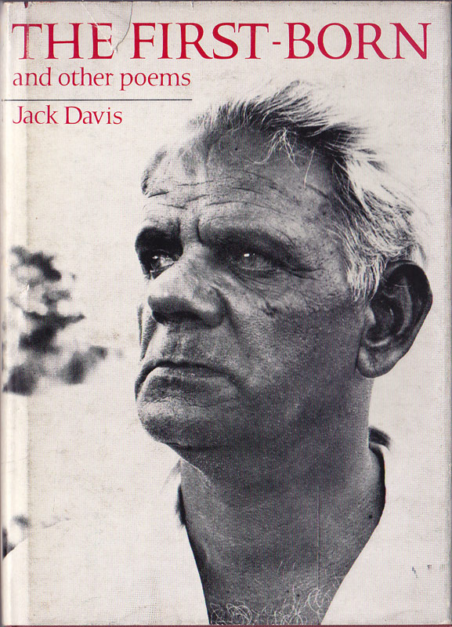
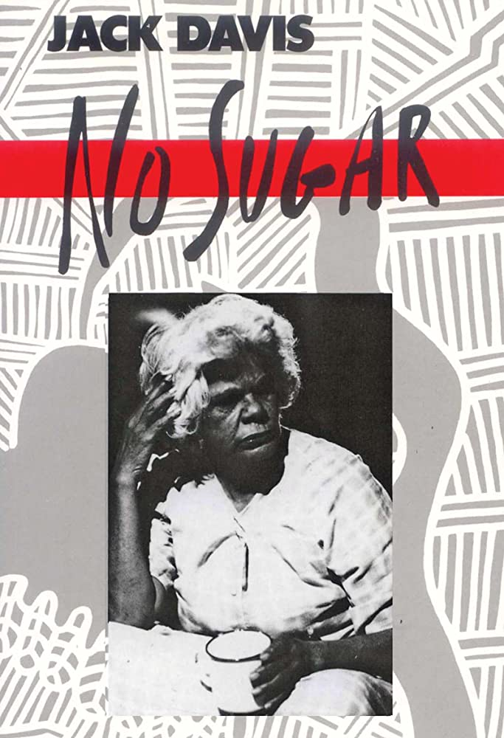
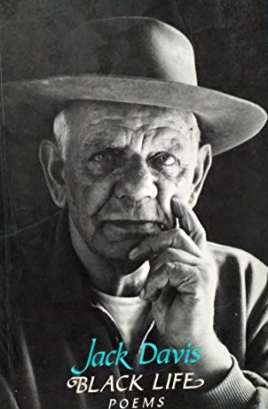
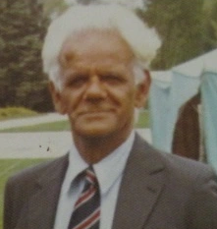
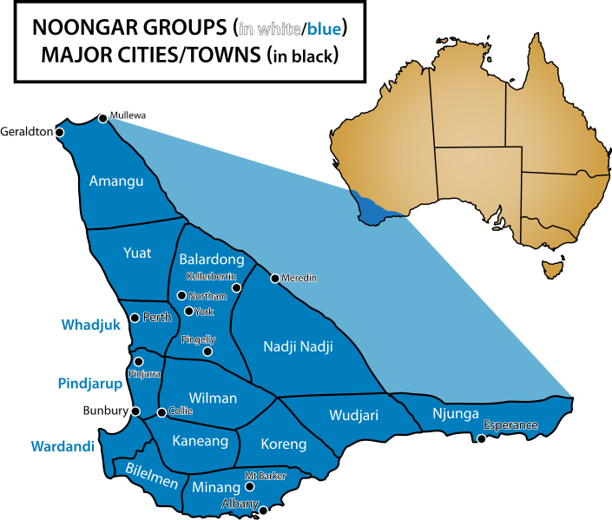
Notes:
Wagyl and the sacred hydrologies of the Southwest region appear prominently in the writing of Jack Davis, a Noongar poet, playwright and activist. The publication of The First-Born and Other Poems in 1970 distinguished Davis as the second Indigenous Australian writer, after Oodgeroo Noonuccal, to publish a poetry collection. Davis’ hydropoetic sensibility is also palpable in No Sugar from 1986, a four-act play set in the 1920s and 1930s at Moore River Native Settlement and other locales in Western Australia.

Slide 6
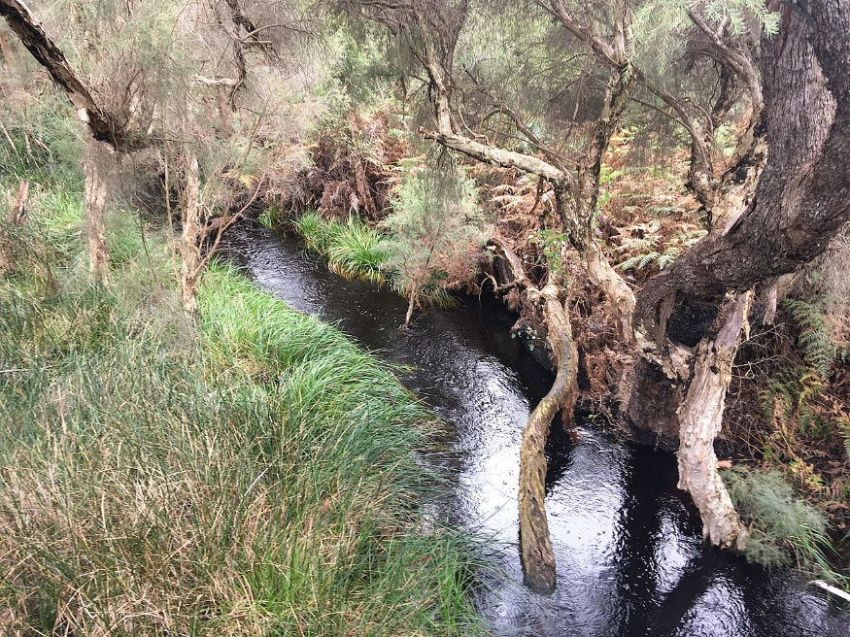
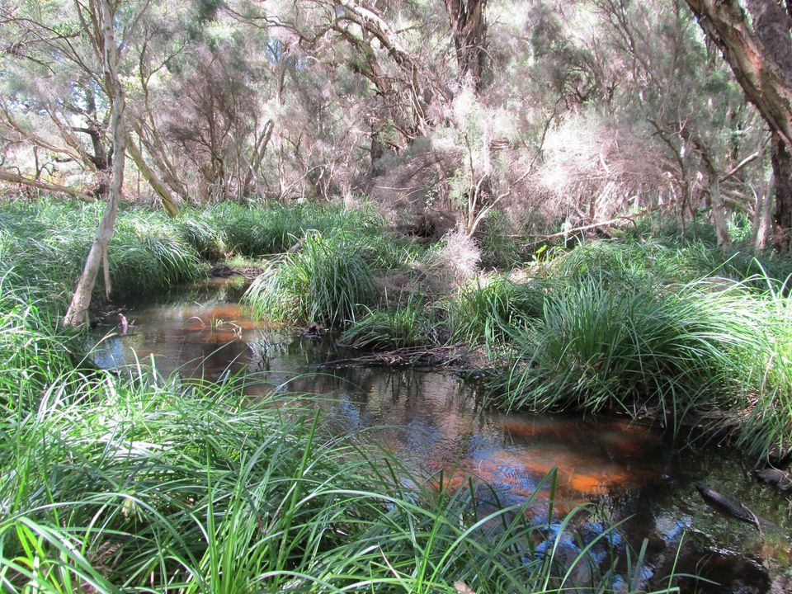
‘The Fight To Save Bennett Brook’ (1992)
It is all that is left of
part of the occupation
of a nation
for forty thousand years
The brook now bears
an alien name
The sound of trucks
and whorls of dust bring shame
and paint phantom figures
in the air
[…]
We are but swamp reeds
standing in the sun
but resilient
bending with each blow.
-Jack Davis from Black Life (1992, 61)
Bennett Brook, Perth, Western Australia
Notes:
Davis’ poem “The Fight To Save Bennett Brook” exhibits catchment consciousness while protesting the disturbance of the brook’s sacred hydrology. Bennett Brook physically connects Derbarl Yerrigan to the Gnangara Mound, a major aquifer that supplies most of Perth’s drinking water. In the poem, “The brook now bears / an alien name,” a reference to the overwriting of Noongar place names by Anglo-European toponyms. The Whadjuck Noongar of the Perth area know Bennett Brook as Korndiny Karla Boodjar or “big fire and camping place,” signifying the cultural importance of the brook to cooking, eating, sheltering and socialising. Despite the brook’s sacred standing, “The sound of trucks / and whorls of dust” epitomise the ongoing fragmentation of the cultural ecologies of Korndiny Karla Boodjar. Human-water-plant intercorporeality, however, offers a mode of resistance through solidarity between people and other life forms: “We are but swamp reeds / standing in the sun / but resilient / bending with each blow.” Speaking on behalf of Noongar people—as a “we”—the narrator identifies with the robust plant life of the brook’s wetland habitats.

Slide 7
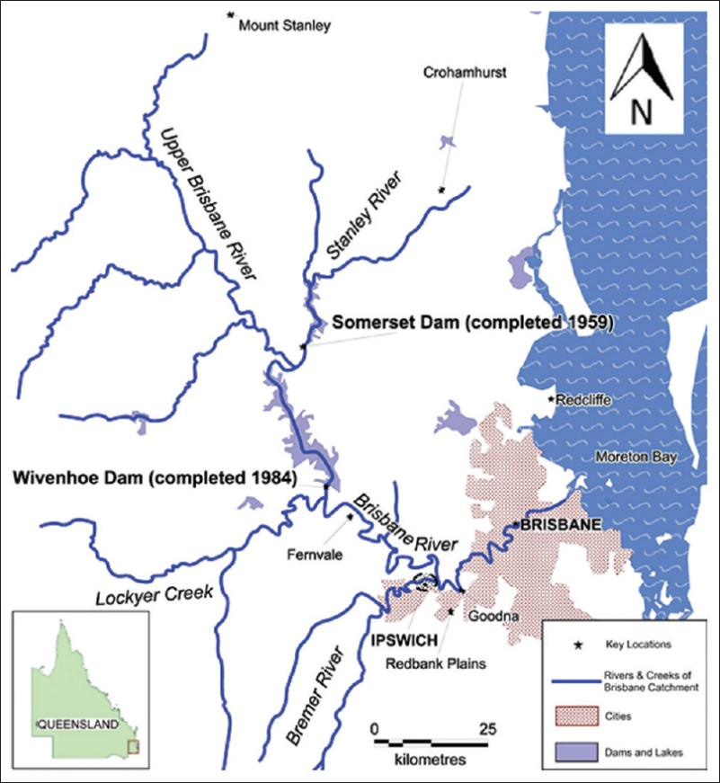
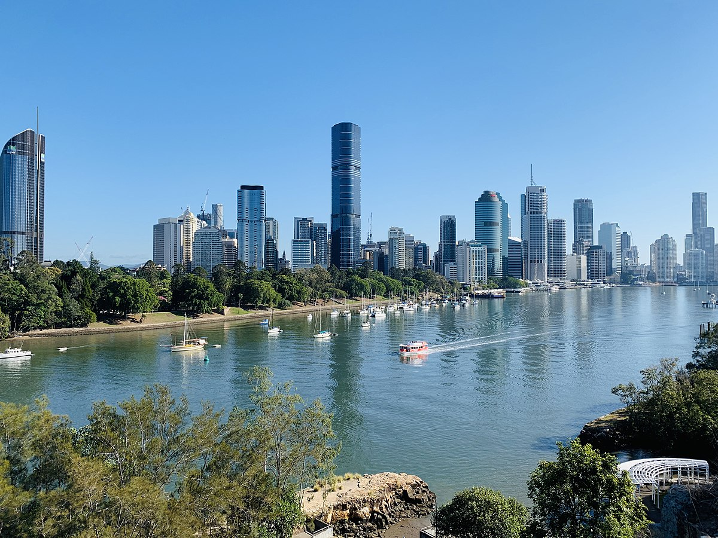
Maiwar and Moodagurra
Samuel Wagan Watson’s Brisbane River Hydropoetics
Left: Map of the Brisbane River from source to sea Right: The Brisbane River near the city of Brisbane, Queensland
Notes:
As the longest river in Southeast Queensland, Maiwar (the Brisbane River) flows about 350 kilometres from Mount Stanley to Moreton Bay on the Coral Sea, passing through the traditional lands of several Aboriginal nations. The Turrbal are the Indigenous people of Mianjin (present-day Brisbane City) whose Country surrounds the river from Moreton Bay through Brisbane CBD and westward.

Slide 8
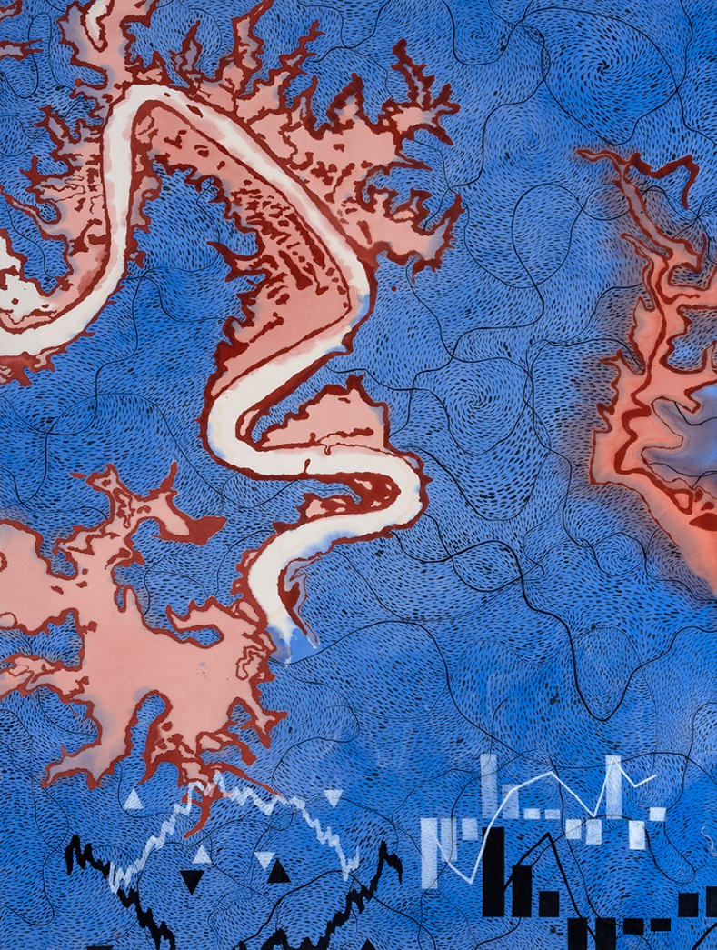
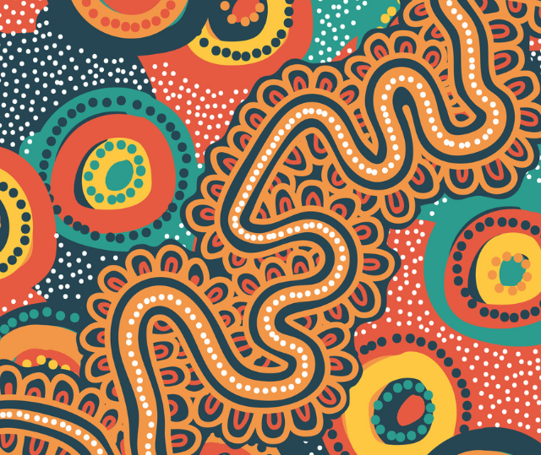
Left: water dragon by Judy Watson (2011) Right: Meanjin Gatherings by Casey Coolwell (2018)
Notes:
For Maiwar’s Indigenous caretakers, the rainbow serpent, Moodagurra, created the river during Dreamtime. In the narrative, Moodagurra becomes stuck as she travels up a dry creek, so she appeals to Yara (rain) and Ngalan (clouds) for assistance. The two Ancestor Beings bring about thunderous rain that washes under Moodagurra’s belly, enabling her to squirm free from the creekbed. As Moodagurra proceeds farther up the creek, her writhing motions produce Maiwar’s curving path. The river’s creation story features in the two artworks shown here, water dragon by Judy Watson on the left and Meanjin Gatherings by Casey Coolwell on the right.

Slide 9
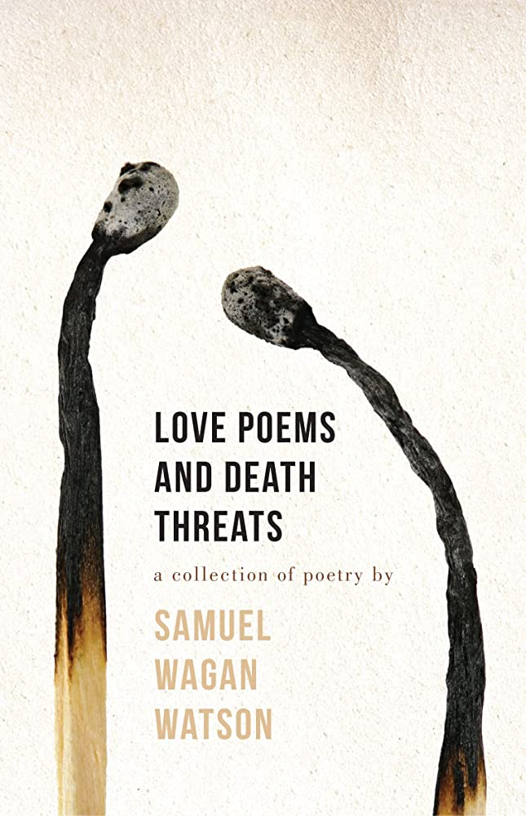
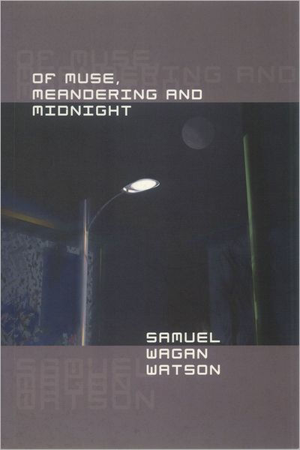
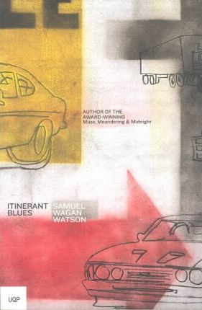
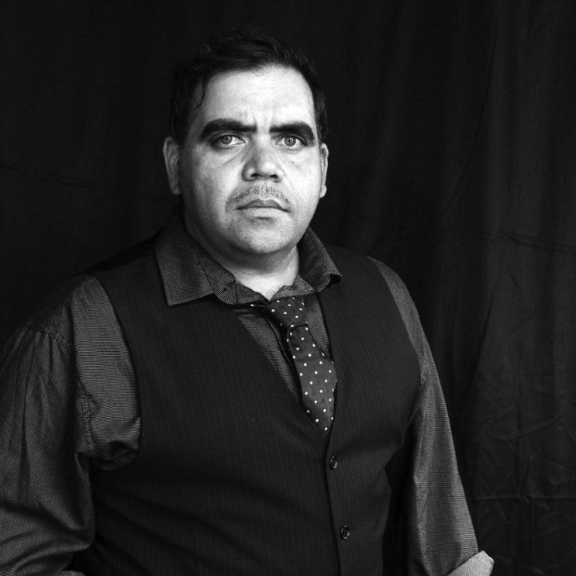
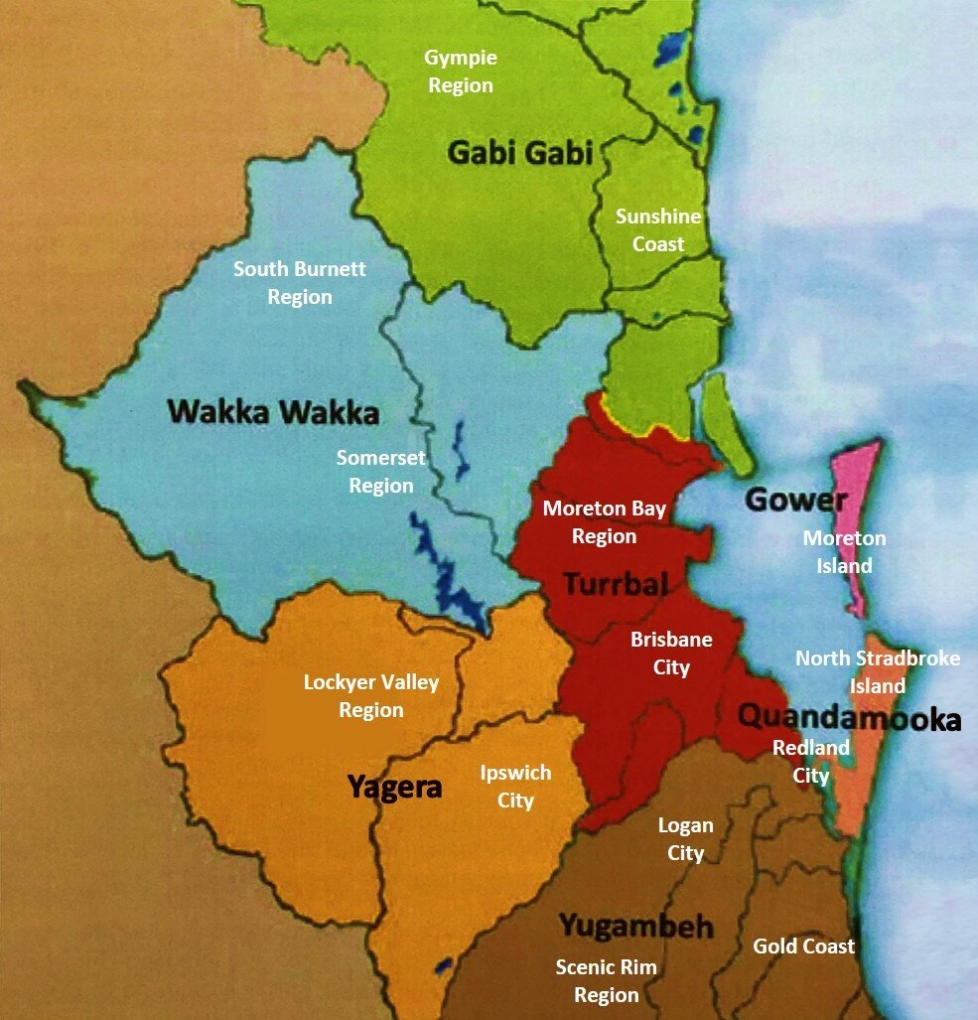
Notes:
As a material and spiritual omnipresence, Maiwar figures extensively in the writing of Samuel Wagan Watson, a poet of Irish, German, Dutch and Indigenous (Munaldjali and Birri Gubba) descent. In addition to publishing his work in print format, Watson has inscribed poetry in Brisbane’s built environment such as the Eleanor Schonell Bridge, or Green Bridge, that traverses the Brisbane River near the suburb of St Lucia. Watson’s work celebrates Indigenous heritage through stories of the Brisbane environment including of Maiwar and the Dreaming Ancestors of the fluvial environment.

Slide 10
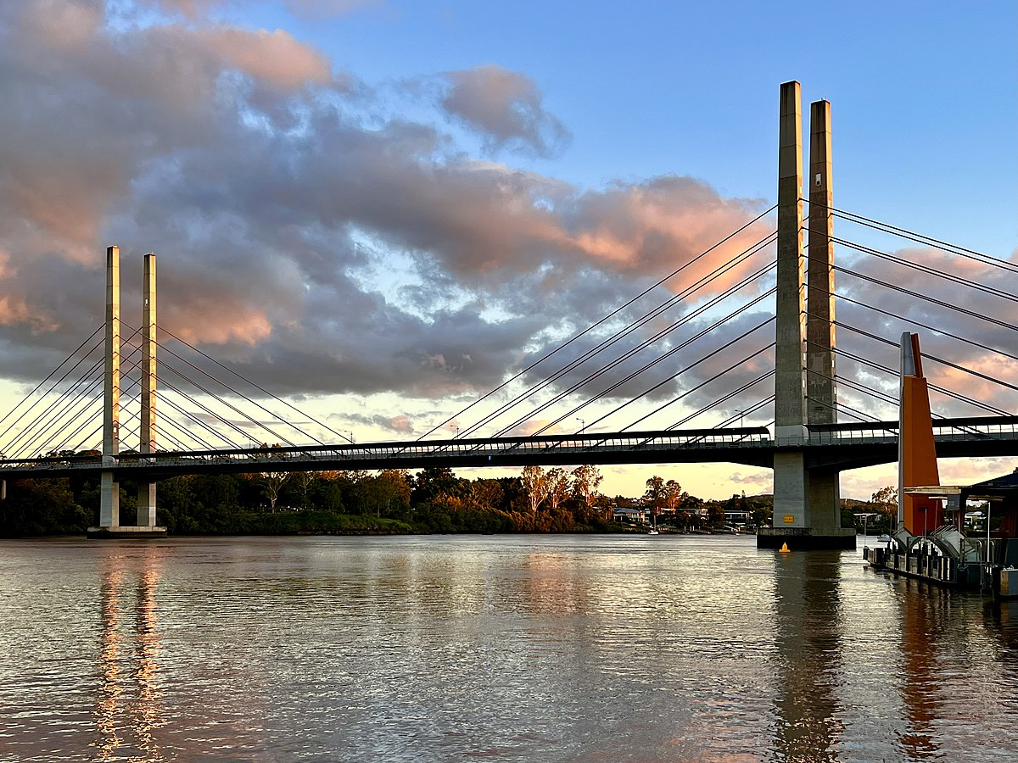
‘Poetry on the Green Bridge’ (2014)
On the transom of ghosts
(An interactive poem for the commuter)
On this transom, the river’s dawning skin … stand
here … give your breath to the fleeting mist … stand
here … in the crimson showdown of Coot-tha’s dusk … stand
here … and whisper upon night’s canvas, whirlpool eyes, the
songlines of Kurilpa ghosts …
Dreaming river triptych
Never the same this river – archaic vein, snaking through
the land’s dreaming cortex –
submerging provinces; the past, present and future – an
aquarelle triptych cultured on every tide …
-Samuel Wagan Watson from Love Poems and Death Threats (2014, p. 33)
Notes:
Imprinted on the reinforcing crossbars of Eleanor Schonell Bridge, Watson’s “Poetry on the Green Bridge” evinces an Indigenous hydropoetics of Maiwar shaped by the Dreamings of Brisbane-area Aboriginal cultures. Evoking Maiwar’s power, presence, and poiesis, the poem comprises two short parts, “On the Transom of Ghosts” and “Dreaming River Triptych.” Inviting passersby to appreciate Maiwar flowing beneath them, the first part is “an interactive poem for the commuter.” In the poem-imprint, the river is a songline or Dreaming track: “On this transom, the river’s dawning skin … stand / here […] and whisper upon night’s canvas, whirlpool eyes, the / songlines of Kurilpa ghosts.” Meaning “place for water rats,” the term Kurilpa is the Indigenous appellation for the land occupied by the suburbs of West End and South Brisbane. The poem’s second part captures the perpetual transformation and renewal of Maiwar over immense stretches of time as Watson mediates the presence of Moodagurra through the figure of the serpent: “Never the same this river—archaic vein, snaking through / the land’s dreaming cortex.”

Slide 11
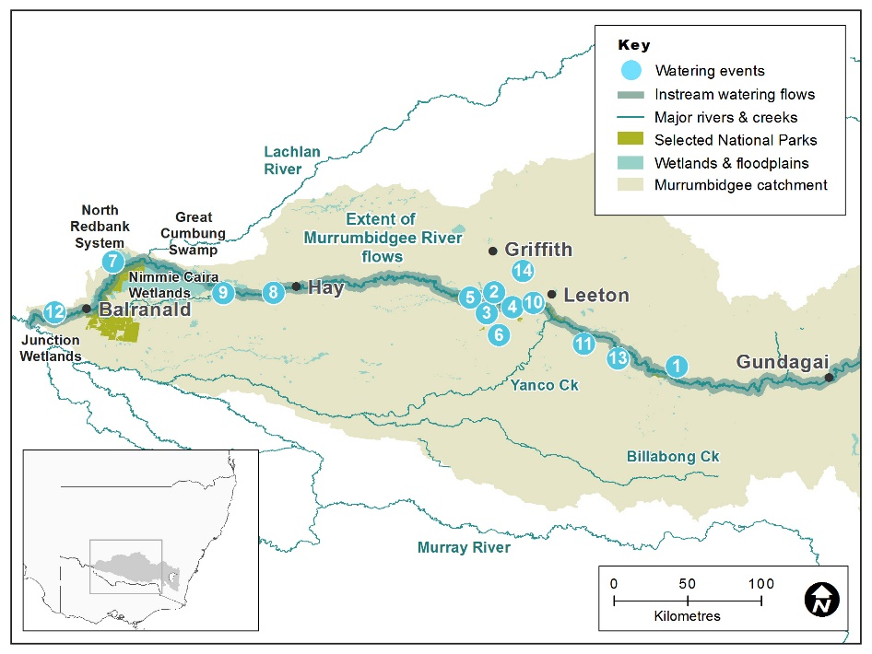
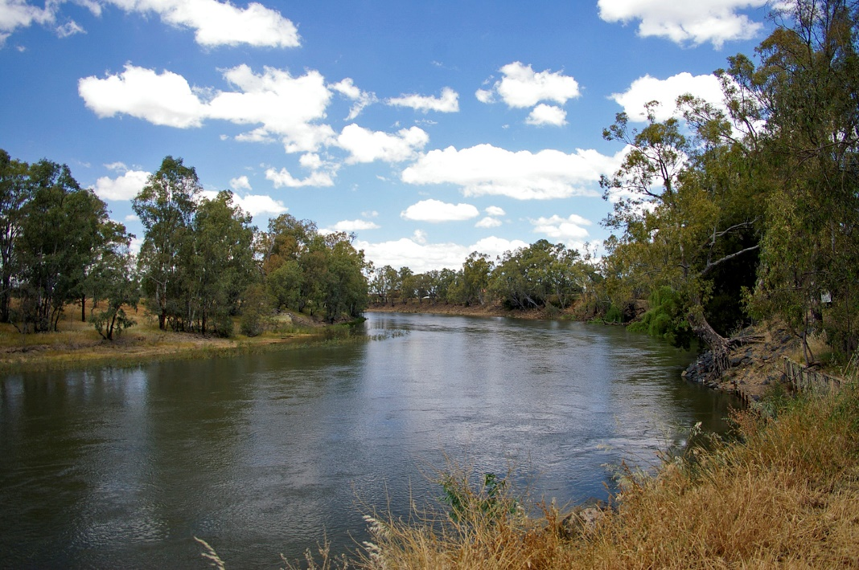
Marrambidya Bila and Girawu
Jeanine Leane’s Murrumbidgee River Hydropoetics
Left: Map of the Murrumbidgee River from source to sea Right: The Murrumbidgee River near the town of Wagga Wagga, NSW
Notes:
Stretching 1,485 kilometres through New South Wales and the Australian Capital Territory, Marrambidya Bila (the Murrumbidgee River) is Australia’s third longest river and a major tributary of the Murray River. Along the way, Marrambidya Bila crosses the traditional lands of multiple Aboriginal cultural groups including the Wiradjuri nation.

Slide 12
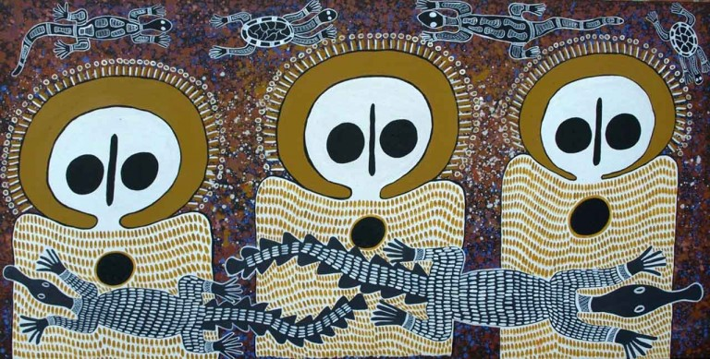
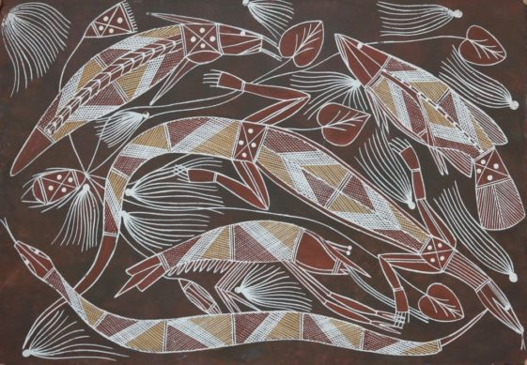
Top: Oenpelli - artist unknown, Goanna, Snake, Fish
Right: Alison Burgu, Wandjina & Unguds
Notes:
The Creation Being connected to Marrambidya Bila is Girawu, the goanna wife who unleashed water from the mountains, forming an extensive hydrological system. During the Dreaming, there is no river. Animals die of thirst on the dry land. Only the goannas are healthy. Other creatures begin to wonder if the goannas have a clandestine water supply. Growing impatient with their husbands, the goanna wives decide to search for the water cache. On arriving at the mountain, Girawu sits down but awakens suddenly to a band of little men. The group’s elder reassures Girawu that they will lead her to the sacred water. Reaching the source, she drinks to her fill then asks the elder how to assist the desperate animals. The elder instructs Girawu to bring her sister goannas to the mountain so she departs and soon returns with them all. The little men tell Girawu to thrust her yam-digging stick into the mountain and run away immediately. On heeding the directions, a water torrent gushes from the earth, pours down the valley to Dhungalla (the Murray River). Indeed, the goanna features in many Aboriginal creation narratives as depicted by these artworks, the top left by an unknown artist and the bottom right by Alison Burgu.

Slide 13
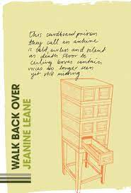
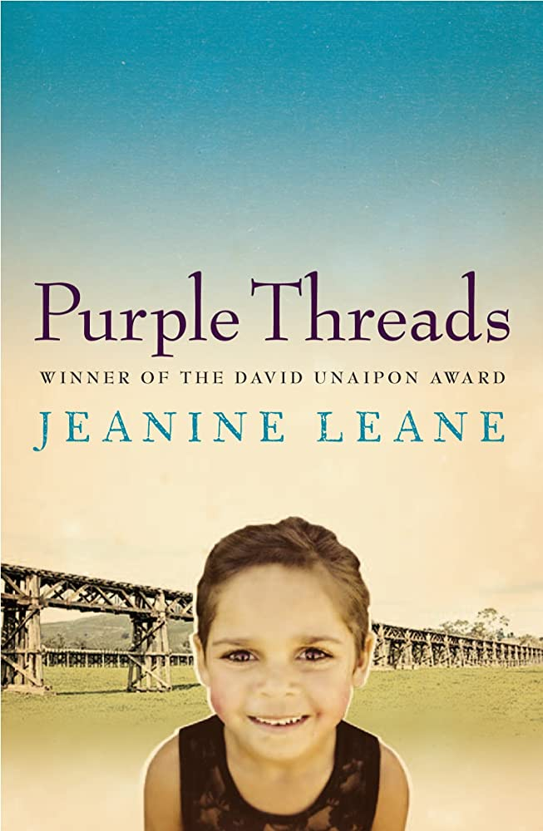
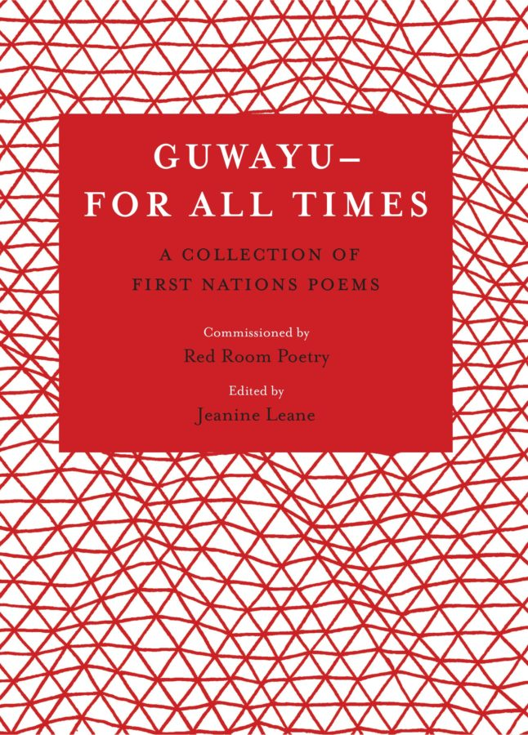
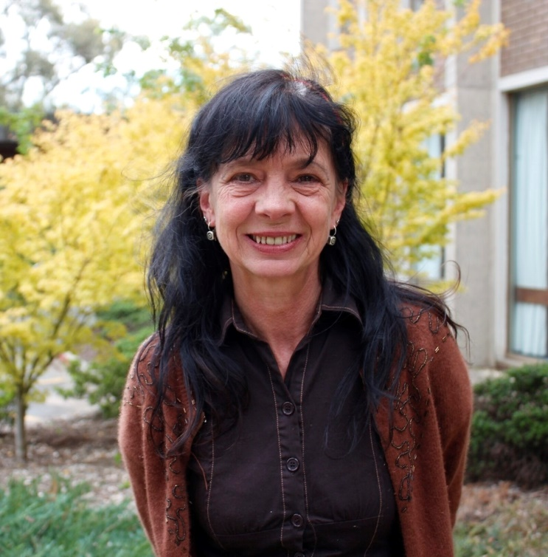
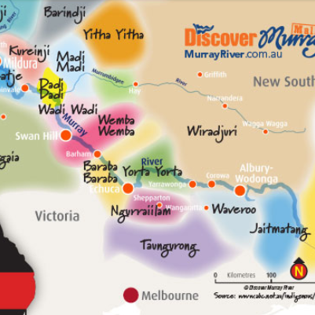
Notes:
As a fluvial entity saturated with stories, Marrambidya Bila recurs throughout the work of Jeanine Leane, a Wiradjuri poet, novelist and researcher from south-west New South Wales. More specifically, Leane’s hydropoetics probes the dialectical nature of memory. The idea of river memory developed in her work encompasses Aboriginal people’s memories of Marrambidya Bila over deep cultural time, from the Dreaming through the turmoil of the settler era through to the present. Yet the river is also memory incarnate—a remembering subject and “a deep archive”—with the capacity to hold Country, Wiradjuri people and all beings in memory.

Slide 14
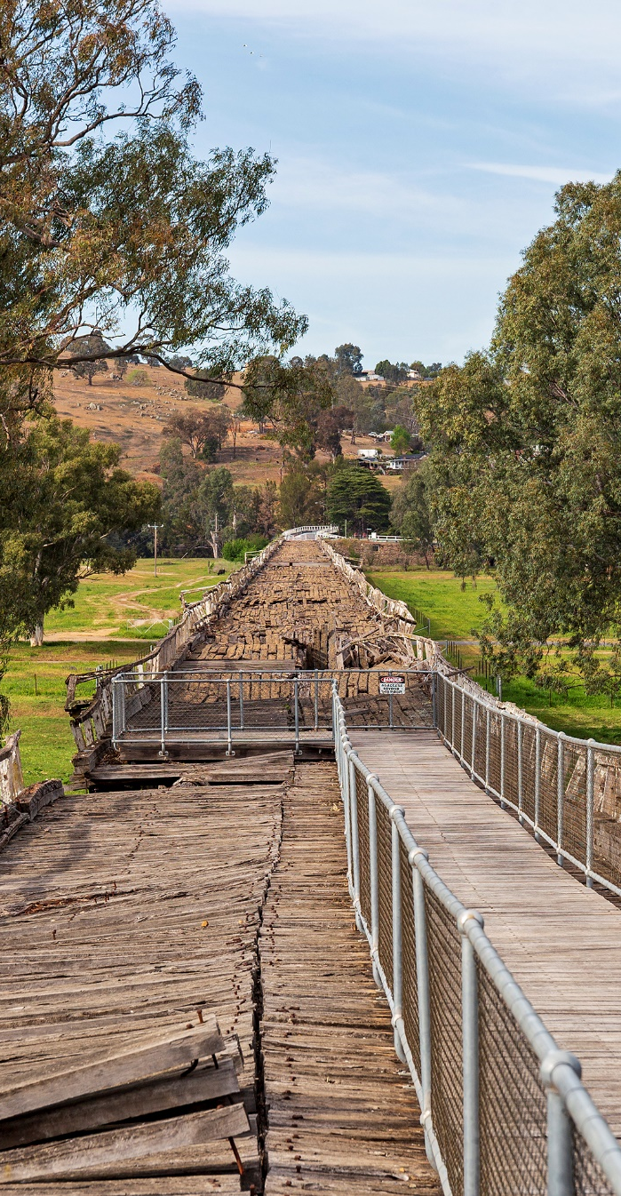
‘Bridge Over River Memory’ (2018)
The water under the bridge ripples over
my memory now. The bend of the
Murrumbidgee—a deep archive—
flows steady and slow.
I walk on the bridge and I remember how
long it used to take to cross on my little
legs clinging tight to the side rail as huge
wheat and wool trucks thundered over the
ancient planks laden with the wealth
of the nation.
Sometimes the river rose so high it swallowed
the bridge and the town. Short history almost
washed away by higher, older tides.
No trucks now. The bridge long ago closed—
steel and concrete girders bypass the town.
The wealth of the nation rumbles down
different roads.
-Jeanine Leane from Walk Back Over (2018)
Prince Alfred Bridge, Gundagai, NSW
Notes:
Leane’s most concertedly fluvial poem is “Bridge Over the River Memory.” Memory in the poem traverses human and the more-than-human domains. The river is both a subject of memory and a remembering subject. Multidimensional modes of memory mix together like currents as the poet recalls the force of Marrambidya Bila rising so high the river “swallowed / the bridge and the town.” The narrative’s mnemonic focal point is the bridge, one of the longest wooden bridges in the world, constructed of local trees such as river red gum, a species growing throughout Australia in floodplains and along the banks of watercourses. Like Marrambidya Bila, the trees afforded the raw materials of colonial expansion yet their histories have been elided: “How many river gums were felled? What / were their names before they were rearranged / across the river—once their life blood. / What was their history?” For gum trees—as for Wiradjuri people—the river is “their life blood.” Reasserting Indigenous memory, then, necessitates excavating fluvial and arboreal histories. The poem evokes the coursing of memory through place, people, trees and rivers in an inter-mnemonic flow: “The water under the bridge ripples over / my memory now. The bend of the / Murrumbidgee—a deep archive— / flows steady and slow.” As narratives such as the Dreaming of Girawu, the goanna wife, also demonstrate, Marrambidya Bila is a deep archive of Wiradjuri memory.

Slide 15
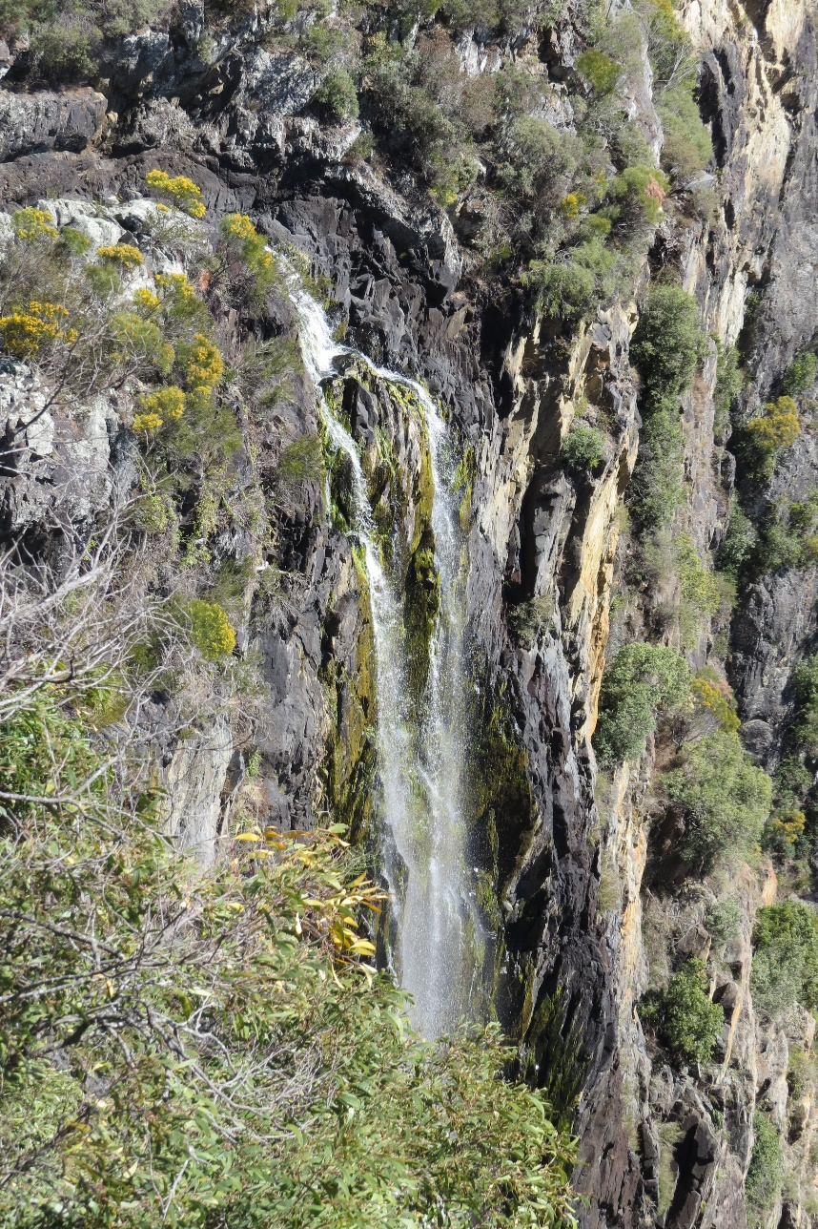
Conclusion
forwards an Indigenous hydropoetics immersed in Aboriginal creation narratives
emphasises the embodied relations between humans, rivers, and all life.
evokes the poiesis—the dynamic emergence or bringing forth—of sacred rivers whose origins lie in the Dreaming
confronts aquatic conservation urgencies in Australia
presents a medium for reverent listening to rivers
Waterfall near Armidale, NSW
Notes:
The writing of Davis, Watson and Leane forwards an Indigenous hydropoetics immersed in Aboriginal creation narratives and emphasises the embodied relations between humans, rivers and all life. Their work evokes the poiesis—the dynamic emergence or bringing forth—of sacred rivers whose origins lie in the Dreaming while also confronting aquatic conservation urgencies in Australia. Poetry such as theirs presents a medium for reverent listening to rivers.

Slide 16
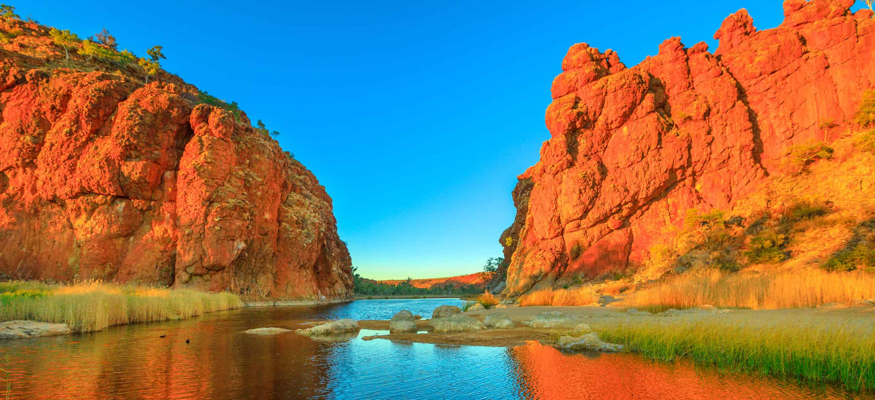


Thank you for listening…
John Charles Ryan, PhD
john.c.ryan@scu.edu.au
Notes:
Thank you

